Slide 1
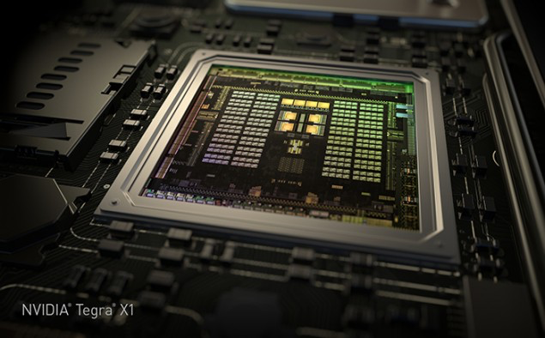
GPU Computing Architecture
/
HiPEAC Summer School, July 2015
Tor M. Aamodt
aamodt@ece.ubc.ca
University of British Columbia
NVIDIA Tegra X1 die photo

Slide 2
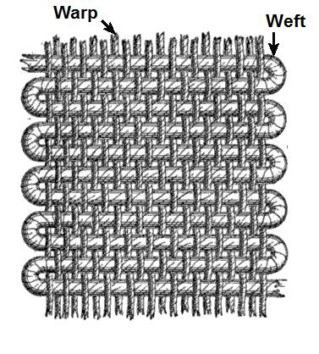
SIMT Execution Model
Programmers sees MIMD threads (scalar)
GPU bundles threads into warps (wavefronts) and runs them in lockstep on SIMD hardware
An NVIDIA warp groups 32 consecutive threads together (AMD wavefronts group 64 threads together)
Aside: Why “Warp”? In the textile industry, the term “warp” refers to “the threads stretched lengthwise in a loom to be crossed by the weft” [Oxford Dictionary].
[https://en.wikipedia.org/wiki/Warp_and_woof]
Notes:
MIMD = multiple-instruction, multiple-data

Slide 3
SIMT Execution Model
Challenge: How to handle branch operations when different threads in a warp follow a different path through program?
Solution: Serialize different paths.
foo[] = {4,8,12,16};
A
T1
T2
T3
T4
A: v = foo[threadIdx.x];
B: if (v < 10)
C: v = 0;
else
D: v = 10;
E: w = bar[threadIdx.x]+v;
B
T1
T2
T3
T4
C
Time
T1
T2
D
T3
T4
E
T1
T2
T3
T4
Notes:
MIMD = multiple-instruction, multiple-data

Slide 4
GPU Memory Address Spaces
GPU has three address spaces to support increasing visibility of data between threads: local, shared, global
In addition two more (read-only) address spaces: Constant and texture.

Slide 5
Local (Private) Address Space
Each thread has own “local memory” (CUDA) “private memory” (OpenCL).
0x42
Note: Location at address 100 for thread 0 is different from location at address 100 for thread 1.
Contains local variables private to a thread.

Slide 6
Global Address Spaces
Each thread in the different thread blocks (even from different kernels) can access a region called “global memory” (CUDA/OpenCL).
Commonly in GPGPU workloads threads write their own portion of global memory. Avoids need for synchronization—slow; also unpredictable thread block scheduling.
thread block X
thread block Y
0x42

Slide 7
Shared (Local) Address Space
Each thread in the same thread block (work group) can access a memory region called “shared memory” (CUDA) “local memory” (OpenCL).
Shared memory address space is limited in size (16 to 48 KB).
Used as a software managed “cache” to avoid off-chip memory accesses.
Synchronize threads in a thread block using __syncthreads();
thread block
0x42

Slide 8
Review: Bank Conflicts
To increase bandwidth common to organize memory into multiple banks.
Independent accesses to different banks can proceed in parallel
Bank 0
Bank 1
Bank 0
Bank 1
Bank 0
Bank 1
0
2
4
6
1
3
5
7
0
2
4
6
1
3
5
7
0
2
4
6
1
3
5
7
Example 1: Read 0, Read 1
(can proceed in parallel)
Example 2: Read 0, Read 3
(can proceed in parallel)
Example 3: Read 0, Read 2
(bank conflict)

Slide 9
Shared Memory Bank Conflicts
__shared__ int A[BSIZE];
…
A[threadIdx.x] = … // no conflicts
0
32
64
96
1
33
65
97
2
34
66
98
31
63
95
127

Slide 10
Shared Memory Bank Conflicts
__shared__ int A[BSIZE];
…
A[2*threadIdx.x] = // 2-way conflict
0
32
64
96
1
33
65
97
2
34
66
98
31
63
95
127

Slide 11
CUDA Streams
CUDA (and OpenCL) provide the capability to overlap computation on GPU with memory transfers using “Streams” (Command Queues)
A Stream orders a sequence of kernels and memory copy “operations”.
Operations in one stream can overlap with operations in a different stream.

Slide 12
How Can Streams Help?
Serial:
Streams:
cudaMemcpy(H2D)
kernel<<<>>>
cudaMemcpy(D2H)
GPU idle
GPU busy
GPU idle
cudaMemcpy(H2D)
K0
DH0
K1
DH1
Savings
K2
DH2
Time
http://on-demand.gputechconf.com/gtc-express/2011/presentations/StreamsAndConcurrencyWebinar.pdf

Slide 13
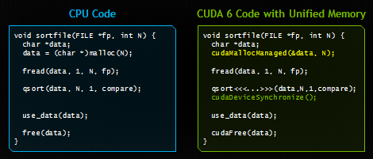
Recent Features in CUDA
Dynamic Parallelism (CUDA 5): Launch kernels from within a kernel. Reduce work for e.g., adaptive mesh refinement.
Unified Memory (CUDA 6): Avoid need for explicit memory copies between CPU and GPU
http://devblogs.nvidia.com/parallelforall/unified-memory-in-cuda-6/
See also, Gelado, et al. ASPLOS 2010.

Slide 14
GPU Instruction Set Architecture (ISA)
NVIDIA defines a virtual ISA, called “PTX” (Parallel Thread eXecution)
More recently, Heterogeneous System Architecture (HSA) Foundation (AMD, ARM, Imagination, Mediatek, Samsung, Qualcomm, TI) defined the HSAIL virtual ISA.
PTX is Reduced Instruction Set Architecture (e.g., load/store architecture)
Virtual: infinite set of registers (much like a compiler intermediate representation)
PTX translated to hardware ISA by backend compiler (“ptxas”). Either at compile time (nvcc) or at runtime (GPU driver).

Slide 15
Some Example PTX Syntax
Registers declared with a type:
.reg .pred p, q, r;
.reg .u16 r1, r2;
.reg .f64 f1, f2;
ALU operations
add.u32 x, y, z; // x = y + z
mad.lo.s32 d, a, b, c; // d = a*b + c
Memory operations:
ld.global.f32 f, [a];
ld.shared.u32 g, [b];
st.local.f64 [c], h
Compare and branch operations:
setp.eq.f32 p, y, 0; // is y equal to zero?
@p bra L1 // branch to L1 if y equal to zero

Slide 16
Part 2: Generic GPGPU Architecture

Slide 17
Extra resources
GPGPU-Sim 3.x Manualhttp://gpgpu-sim.org/manual/index.php/GPGPU-Sim_3.x_Manual

Slide 18
GPU Microarchitecture Overview
Single-Instruction, Multiple-Threads
GPU
SIMT Core Cluster
SIMT Core Cluster
SIMT Core Cluster
SIMT
Core
SIMT
Core
SIMT
Core
SIMT
Core
SIMT
Core
SIMT
Core
Interconnection Network
Memory
Partition
Memory
Partition
Memory
Partition
GDDR5
GDDR5
Off-chip DRAM
GDDR5

Slide 19
GPU Microarchitecture
Companies tight lipped about details of GPU microarchitecture.
Several reasons:
  Competitive advantage
  Fear of being sued by “non-practicing entities”
  The people that know the details too busy building the next chip
Model described next, embodied in GPGPU-Sim, developed from: white papers, programming manuals, IEEE Micro articles, patents.

Slide 20
GPGPU-Sim v3.x w/ SASS
Correlation
~0.976
12

Slide 21
GPU Microarchitecture Overview
GPU
SIMT Core Cluster
SIMT Core Cluster
SIMT Core Cluster
SIMT
Core
SIMT
Core
SIMT
Core
SIMT
Core
SIMT
Core
SIMT
Core
Interconnection Network
Memory
Partition
Memory
Partition
Memory
Partition
GDDR3/GDDR5
GDDR3/GDDR5
Off-chip DRAM
GDDR3/GDDR5

Slide 22
Inside a SIMT Core
SIMT
Front End
Reg
File
SIMD Datapath
Fetch
Decode
Memory Subsystem
Icnt.
Network
Schedule
Branch
SMem
L1 D$
Tex $
Const$
SIMT front end / SIMD backend
Fine-grained multithreading
  Interleave warp execution to hide latency
  Register values of all threads stays in core

Slide 23
Inside an “NVIDIA-style” SIMT Core
SIMT Front End
SIMD Datapath
Branch Target PC
Fetch
SIMT-Stack
Scheduler 1
Scheduler 3
ALU
Valid[1:N]
Active
ALU
I-Buffer
Pred.
ALU
Mask
ALU
I-Cache
Decode
Issue
Operand
Scheduler 2
Collector
Score
MEM
Board
Done (WID)
Three decoupled warp schedulers
Scoreboard
Large register file
Multiple SIMD functional units

Slide 24
Fetch + Decode
Arbitrate the I-cache among warps
  Cache miss handled by fetching again later
Fetched instruction is decoded and then stored in the I-Buffer
  1 or more entries / warp
  Only warp with vacant entries are considered in fetch
Score-
PC
Decode
Board
A
1
PC
v
Inst. W1
r
R
2
e
B
PC
3
v
Inst. W2
r
h
c
v
Inst. W3
r
a
C
-
I
o
Selection
T
To
Fetch
Issue
Valid[1:N]
Issue
ARB
Fetch
Valid[1:N]
I-Buffer
I-Cache
Decode

Slide 25
Instruction Issue
Select a warp and issue an instruction from its
I-Buffer for execution
  Scheduling: Greedy-Then-Oldest (GTO)
  GT200/later Fermi/Kepler:
  Allow dual issue (superscalar)
  Fermi: Odd/Even scheduler
  To avoid stalling pipeline might
  keep instruction in I-buffer until
  know it can complete (replay)

Slide 26
Review: In-order Scoreboard
+
Scoreboard: a bit-array, 1-bit for each register
  If the bit is not set: the register has valid data
  If the bit is set: the register has stale data
    i.e., some outstanding instruction is going to change it
Issue in-order: RD ← Fn (RS, RT)
  If SB[RS] or SB[RT] is set → RAW, stall
  If SB[RD] is set → WAW, stall
  Else, dispatch to FU (Fn) and set SB[RD]
Complete out-of-order
  Update GPR[RD], clear SB[RD]
Scoreboard
Register File
0
Regs[R1]
1
Regs[R2]
0
Regs[R3]
0
Regs[R31]
[Gabriel Loh]
Notes:
H&P-style notation

Slide 27
Example
+
Code
ld r7, [r0]
mul r6, r2, r5
add r8, r6, r7
Scoreboard
Instruction Buffer
Index 0
Index 1
Index 2
Index 3
i0 i1 i2 i3
Warp 0
r7 | - | - | -
- | - | - | -
r7 | r6 | - | -
- | - | - | -
r7 | r6 | r8 | -
- | - | - | -
r7 | r6 | r8 | -
- | - | - | -
r7 | - | r8 | -
- | - | - | -
r7 | - | r8 | -
- | - | - | -
- | - | r8 | -
- | - | - | -
Warp 0
- | - | - | -
- | - | - | -
ld r7, [r0] | 0 | 0 | 0 | 0
ld r7, [r0] | 0 | 0 | 0 | 0
mul r6, r2, r5 | 0 | 0 | 0 | 0
ld r7, [r0] | 0 | 0 | 0 | 0
mul r6, r2, r5 | 0 | 0 | 0 | 0
add r8, r6, r7 | 1 | 1 | 0 | 0
ld r7, [r0] | 0 | 0 | 0 | 0
mul r6, r2, r5 | 0 | 0 | 0 | 0
add r8, r6, r7 | 1 | 1 | 0 | 0
ld r7, [r0] | 0 | 0 | 0 | 0
add r8, r6, r7 | 1 | 0 | 0 | 0
ld r7, [r0] | 0 | 0 | 0 | 0
add r8, r6, r7 | 1 | 0 | 0 | 0
add r8, r6, r7 | 0 | 0 | 0 | 0
Warp 1
Warp 1

Slide 28
SIMT Using a Hardware Stack
Stack approach invented at Lucafilm, Ltd in early 1980’s
Version here from [Fung et al., MICRO 2007]
Stack
A
A/1111
Reconv. PC
Next PC
Active Mask
TOS
TOS
TOS
TOS
-
-
-
-
-
-
-
G
A
E
E
B
E
E
1111
1111
1111
1111
1111
1111
1111
E
E
D
D
0110
TOS
E
D
0110
0110
B
B/1111
TOS
TOS
E
E
C
E
1001
1001
C/1001
D/0110
C
D
F
Thread Warp
Common PC
E
E/1111
Thread
1
Thread
2
Thread
3
Thread
4
G
G/1111
A
B
C
D
E
G
A
Time
SIMT = SIMD Execution of Scalar Threads

Slide 29
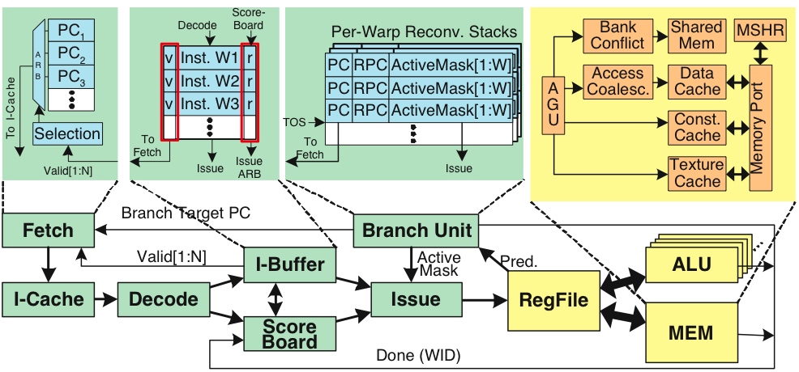
Register File
32 warps, 32 threads per warp, 16 x 32-bit registers per thread = 64KB register file.
Need “4 ports” (e.g., FMA) greatly increase area.
Alternative: banked single ported register file. How to avoid bank conflicts?

Slide 30
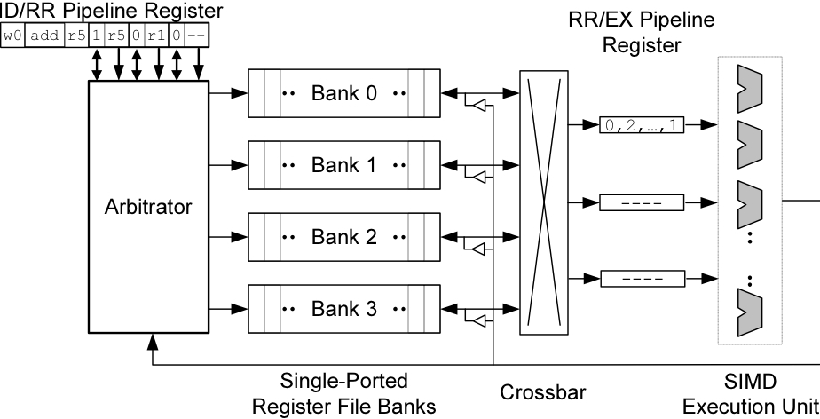
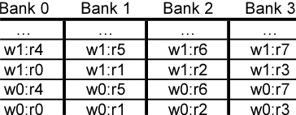
Banked Register File
Strawman microarchitecture:
Register layout:

Slide 31
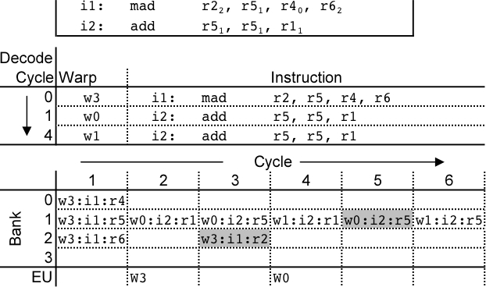
Register Bank Conflicts
warp 0, instruction 2 has two source operands in bank 1: takes two cycles to read.
Also, warp 1 instruction 2 is same and is also stalled.
Can use warp ID as part of register layout to help.

Slide 32
Operand Collector
Bank 0
Bank 1
Bank 2
Bank 3
R0
R1
R2
R3
R4
R5
R6
R7
R8
R9
R10
R11
…
…
…
…
add.s32 R3, R1, R2;
No Conflict
mul.s32 R3, R0, R4;
Conflict at bank 0
Term “Operand Collector” appears in figure in NVIDIA Fermi Whitepaper
Operand Collector Architecture (US Patent: 7834881)
  Interleave operand fetch from different threads to achieve full utilization

Slide 33
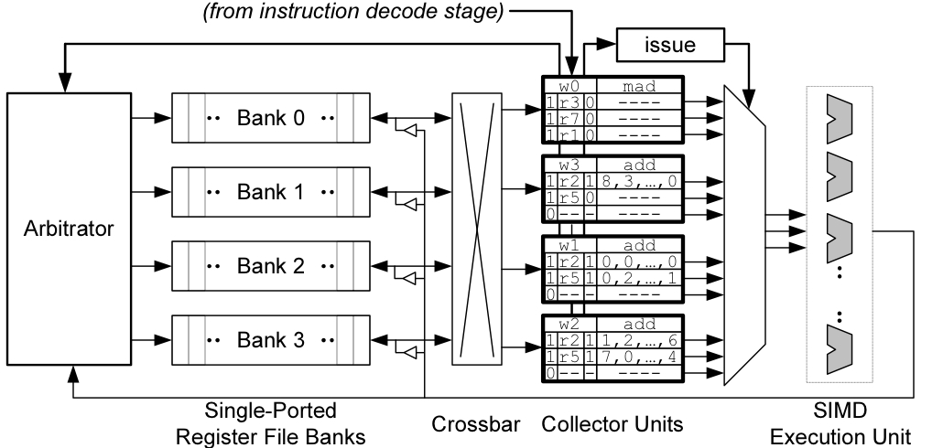
Operand Collector (1)
Issue instruction to collector unit.
Collector unit similar to reservation station in tomasulo’s algorithm.
Stores source register identifiers.
Arbiter selects operand accesses that do not conflict on a given cycle.
Arbiter needs to also consider writeback (or need read+write port)

Slide 34
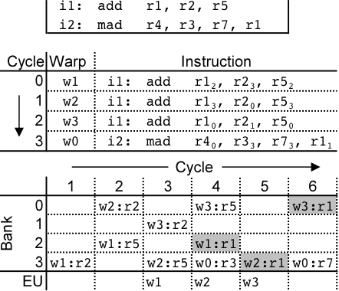
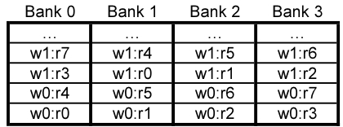
Operand Collector (2)
Combining swizzling and access scheduling can give up to ~ 2x improvement in throughput

Slide 35
Warp Scheduling Basics

Slide 36
Loose Round Robin (LRR)
Goes around to every warp
and issue if ready (R)
If warp is not ready (W),
skip and issue next ready warp
Issue: Warps all run at the same speed,
potentially all reaching memory access
phase together and stalling.
All Warps
R
R
W
R
R
R
W
. . .
R
Select
Execution Units

Slide 37
Two-level (TL)
Warps are grouped into two groups:
  Pending warps
  (potentially waiting on long latency instr.)
  Active warps
  (Ready to execute)
  Warps move between Pending and Active groups
Within the Active group, issue LRR
Goal: Overlap warps performing computation
with warps performing memory access
Pending Warps
P
P
P
P
P
P
P
. . .
P
Active Warps
A
A
A
. . .
A
Select
Execution Units

Slide 38
Greedy-then-oldest (GTO)
Schedule from a single warp until it stalls
Then pick the oldest warp
(time warp assigned to core)
Goal: Improve cache locality for
greedy warp
All Warps
R
R
W
R
R
R
W
. . .
R
Select
Execution Units

Slide 39
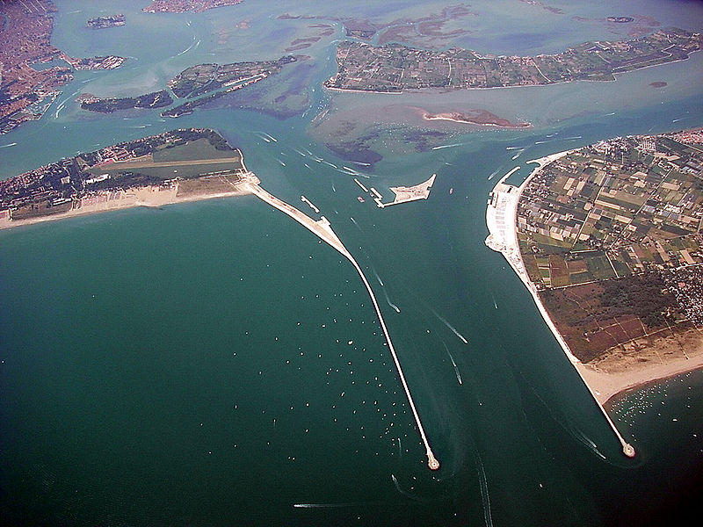

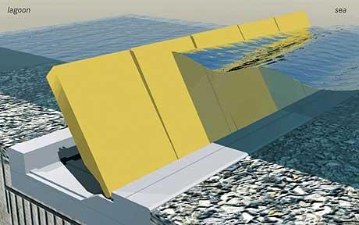


Cache-Conscious Wavefront Scheduling
Timothy G. Rogers¹
Mike O’Connor²
Tor M. Aamodt¹
¹The University of British Columbia
²AMD Research

Slide 40
Wavefronts and Caches
High Level Overview of a GPU
DRAM
DRAM
…
10’s of thousands concurrent threads
High bandwidth memory system
Include data caches
DRAM
L2 cache
Threads in Wavefront
…
Compute Unit
…
Compute Unit
W₁
W₂
…
…
Memory Unit
L1D
ALU
…
Wavefront Scheduler
ALU
ALU

Slide 41
Motivation
Improve performance of highly parallel applications with irregular or data dependent access patterns on GPU
Breadth First Search (BFS)
K-Means (KMN)
Memcached-GPU (MEMC)
Parallel Garbage Collection (GC)
These workloads can be highly cache-sensitive
Increase 32k L1D to 8M
  Minimum 3x speedup
  Mean speedup >5x

Slide 42
Where does the locality come from?
Classify two types of locality
Intra-wavefront locality
Inter-wavefront locality
Wave₀
Wave₁
Wave₀
LD $line (X)
LD $line (X)
LD $line (X)
LD $line (X)
Hit
Hit
Data Cache
Data Cache

Slide 43
Quantifying intra-/inter-wavefront locality
120
Misses PKI
100
Inter-Wavefront Hits PKI
80
(Hits/Miss) PKI
60
40
Intra-Wavefront Hits PKI
20
0
AVG-Highly Cache Sensitive

Slide 44
Observation
Issue-level scheduler chooses the access stream
Round Robin Scheduler
Greedy then Oldest Scheduler
Wave₀
Wave₁
Wave₀
Wave₁
Wavefront Scheduler
Wavefront Scheduler
ld A
,B,C,D…
ld Z,Y,X,W
ld A,B,C,D…
...
...
...
DC
B
A
WX
Y
Z
ld A,B,C,D
ld Z,Y,X,W
ld A,B,C,D…
DC
B
A
DC
B
A
Memory System
Memory System

Slide 45
Difficult Access Stream
Need a better replacement Policy?
Optimal Replacement using RR scheduler
4 hits
A,B,C,D
E,F,G,H
I,J,K,L
A,B,C,D
E,F,G,H
I,J,K,L
W₀
W₁
W₂
W₀
W₁
W₂
L
D
A
B
C
F
E
LRU replacement
12 hits
A,B,C,D
A,B,C,D
E,F,G,H
E,F,G,H
I,J,K,L
I,J,K,L
W₀
W₀
W₁
W₁
W₂
W₂

Slide 46
Why miss rate is more sensitive to scheduling than replacement
1024 threads = thousands of memory accesses
Ld A
Ld C
…
…
Ld E
…
…
Ld B
Ld D
Ld F
Ld A
Ld C
Ld E
1
2
A
W₀
W₁
W₃₁
…
Replacement Policy
Decision limited to one of A possible ways
Wavefront Scheduler
Decision picks from thousands of potential accesses

Slide 47
Does this ever Happen?
Consider two simple schedulers
90
80
70
Loose Round Robin with LRU
  Belady Optimal
Greedy Then Oldest with LRU
60
MPKI
50
40
30
20
10
0
AVG-Highly Cache-Sensitive

Slide 48
Key Idea
Use the wavefront scheduler to shape the access pattern
Greedy then Oldest Scheduler
Cache-Conscious Wavefront Scheduler
Wave₀
Wave₁
Wave₀
Wave₁
Wavefront Scheduler
Wavefront Scheduler
ld A,B,C,D
ld Z,Y,X,W
ld A,B,C,D…
ld Z,Y,X,W…
...
...
...
...
DC
B
A
WX
Y
Z
WX
Y
Z
ld A,B,C,D
ld Z,Y,X,W
ld A,B,C,D…
ld Z,Y,X,W…
WX
Y
Z
DC
B
A
DC
B
A
Memory System
Memory System

Slide 49
CCWS Components
W₂
Locality Scoring System
W₂
W₁
Balances cache miss rate and overall throughput
Score
W₁
W₀
More Details in the Paper
W₀
Time
Lost Locality Detector
Detects when wavefronts have lost intra-wavefront locality
L1 victim tags organized by wavefront ID
Victim Tags
W₀
Tag
Tag
W₁
Tag
Tag
W₂
Tag
Tag

Slide 50
CCWS Implementation
W₂
No W₂ loads
W₂
W₂
W₁
Wave Scheduler
Locality Scoring System
W₁
Score
W₁
W₀
W₀: ld X
W₀
W₀: ld X
W₂: ld Y
W₀
…
Memory Unit
Time
Cache
W₀
detected lost locality
Tag
Y
WID
X
2
Data
0
…
Tag
WID
Data
Victim Tags
More Details in the Paper
W₀,X
W₀
ProbeW₀,X
Tag
X
Tag
W₁
Tag
Tag
W₂
Tag
Tag

Slide 51
Methodology
GPGPU-Sim (version 3.1.0)
30 Compute Units (1.3 GHz)
  32 wavefront contexts (1024 threads total)
32k L1D cache per compute unit
  8-way
  128B lines
  LRU replacement
1M L2 unified cache
Stand Alone GPGPU-Sim Cache Simulator
Trace-based cache simulator
Fed GPGPU-Sim traces
Used for oracle replacement

Slide 52
Performance Results
2
LRR
GTO
CCWS
Also Compared Against
A 2-LVL scheduler
  Similar to GTO performance
A profile-based oracle scheduler
  Application and input data dependent
  CCWS captures 86% of oracle scheduler performance
Variety of cache-insensitive benchmarks
  No performance degradation
1.5
Speedup
1
0.5
0
HMEAN-Highly Cache-Sensitive

Slide 53
Cache Miss Rate
90
80
70
60
CCWS less cache misses than other schedulers optimally replaced
50
MPKI
40
30
20
Full Sensitivity Study in Paper
10
0
AVG-Highly Cache-Sensitive

Slide 54
Related Work
Wavefront Scheduling
Gerogia Tech - GPGPU Workshop 2010
UBC - HPCA 2011
UT Austin - MICRO 2011
UT Austin/NVIDIA/UIUC/Virginia - ISCA 2011
OS-Level Scheduling
SFU – ASPLOPS 2010
Intel/MIT – ASPLOPS 2012

Slide 55
Conclusion
Different approach to fine-grained cache management
Good for power and performance
High level insight not tied specifics of a GPU
  Any system with many threads sharing a cache can potentially benefit
Questions?

Slide 56

Supported by
Warped Gates: Gating Aware Scheduling
and Power Gating for GPGPUs
Mohammad Abdel-Majeed* Daniel Wong*
Murali Annavaram
Ming Hsieh Department of Electrical Engineering
University of Southern California
* Equal Contribution
MICRO-2013

Slide 57
Problem Overview
Execution unit accounts for majority of energy consumption in GPGPU,
even more than Mem and Reg!
Leakage energy is becoming a greater concern with technology scaling
Component Energy Breakdown
for GTX480^{[1]}
Traditional microprocessor power gating techniques are ineffective in GPGPUs
[1] J. Leng, T. Hetherington, A. ElTantawy, S. Gilani, N. S. Kim, T. M. Aamodt, and V. J. Reddi, “GPUWattch: enabling energy optimizations in GPGPUs,” presented at the ISCA '13: Proceedings of the 40th Annual International Symposium on Computer Architecture, 2013.
Overview | 57

Slide 58
GPGPU Overview (GTX480)
SM
V | Dec_INST | R
V | Dec_INST | R
V | Dec_INST | R
Instruction Cache
SFU
LD/ST
C
C
C
C
Operands
Fetch and decode
LD/ST
LD/ST
C
C
C
C
INT Unit
FP Unit
I_Buffer
LD/ST
SFU
LD/ST
C
C
C
C
Warp Scheduler
(2-level)
LD/ST
LD/ST
C
C
C
C
Result Queue
LD/ST
SFU
LD/ST
C
C
C
C
Register File
128KB
LD/ST
LD/ST
C
C
C
C
LD/ST
Execution Units
SFU
LD/ST
C
C
C
C
LD/ST
64KB shared Memory/L1 cache
LD/ST
C
C
C
C
LD/ST
SFU LD/ST SP0 SP1
SP accounts for 98% of Execution Unit Leakage Energy
Execution units account for 68% of total on chip area
Overview | 58

Slide 59
Power Gating Overview
Cuts off leakage current that flows through a circuit block
Power gate at SP granularity
Important Parameters:
  Wakeup Delay – Time to return to Vdd (3 cycles)
  Breakeven Time – # of consecutive power gated cycles required to compensate PG energy overhead (9-24 cycles)
  Idle Detect - # of idle cycles before power gating^{[2]}
Cycles>idle_detect
Busy
Static Energy
Cumulative energy savings
Uncompensated
Idle_detect
Cycles>wakeup_delay
Cycle 1
Eoverhead
Wakeup
Overhead to Sleep
Cycle 1+BET
Overhead to sleep
and Wakeup
[2] Z. Hu, et. al. Microarchitectural techniques for power gating of execution units. In ISLPED ’04.
t0
Compensated
t1
t2
t3
t4
Cycles>BET time
Breakeven Time
Time
Overview | 59

Slide 60
Power Gating Challenges in GPGPUs
Challenges | 60

Slide 61
Power Gating Challenges in GPGPUs
Traditional microprocessors experience idle periods many 10s of cycles long^{[3]}
Int. Unit Idle period length distribution for hotspot
  Assume 5 idle detect, 14 BET
Energy Loss or Neutral
Lost Opportunity
Energy Savings
Need to increase idle period length
[3] S. Dropsho, et. al. Managing static leakage energy in microprocessor functional units. In Proceedings of the MICRO 35, 2012
Challenges | 61

Slide 62
Warp Scheduler Effect on Power Gating
Idle periods
interrupted
by instructions
that are greedily
scheduled
INT
Need to coalesce warp issues
by resource type
FP
INT
INT
FP
INT
Ready Warps
Idle Periods
INT
FP
Challenges | 62

Slide 63
GATES:
Gating Aware Two-level Scheduler
Issue warps based on execution unit resource type
GATES | 63

Slide 64
Gating Aware Two-level Scheduler (GATES)
Idle periods
are coalesced
INT
INT
INT
INT
FP
FP
Ready Warps
Idle Period
INT
FP
GATES | 64

Slide 65
Gating Aware Two-level Scheduler (GATES)
Per instruction type active warps subset
Instruction Issue Priority
Dynamic priority switching
  Switch highest priority when it out of ready warps
Two-level
GATES
GATES | 65

Slide 66
Effect of GATES on Idle Period Length
~3x increase in positive power gating events
~2x increase in negative power gating events
Need to further stretch idle periods
Two-level
GATES
GATES | 66

Slide 67
Blackout Power Gating
Forced idleness of execution units to meet BET
Blackout | 67

Slide 68
Blackout Power Gating
Force idleness until break even time has passed
  Even when there are pending instructions
Would this not cause performance loss?
  No, because of GPGPU-specific large heterogeneity of execution units and good mix of instruction types
Cycles>idle_detect
Busy
Uncompensated
Idle_detect
X
Cycles>wakeup_delay
Cycle 1
X
Wakeup
Cycle 1+BET
Compensated
Cycles>BET time
Blackout | 68

Slide 69
Blackout Power Gating
~2.4x increase in positive PG events over GATES
(GATES ~3x w.r.t. baseline)
GATES
GATES + Blackout
Blackout | 69

Slide 70
Blackout Policies
Naïve Blackout
  GATES and Blackout is independent
Can lead to overaggressive
power gating
Idle Detect
Warp Scheduler
(GATES)
C
C
C
C
C
C
C
C
INT
X
C
C
C
C
C
C
C
C
C
C
C
C
C
C
C
C
C
C
C
C
C
C
C
C
SP0 SP1
Blackout | 70

Slide 71
Blackout Policies
Coordinated Blackout
PG only when active warps
count = 0
Idle Detect
Warp Scheduler
(GATES)
C
C
C
C
Active Warp
Count Based
Dynamic priority switching
is Blackout aware
C
C
C
C
✓
C
C
C
C
INT
C
C
C
C
C
C
C
C
C
C
C
C
C
C
C
C
C
C
C
C
SP0 SP1
Blackout | 71

Slide 72
Impact of Blackout
Some benchmarks still show poor performance
  Not enough active warps to hide forced idleness
Goal is as close to 0% overhead as possible

Slide 73
Adaptive Idle Detect
Reducing Worst Case Blackout Impact
Adaptive Idle Detect | 73

Slide 74
Adaptive Idle Detect
Dynamically change idle detect to avoid aggressive PG
Infer performance loss due to Blackout
  “Critical Wakeup” – Wakeup that occur the moment blackout period ends
High Correlation
vs Runtime
Adaptive Idle Detect | 74

Slide 75
Adaptive Idle Detect
Independent idle detect values for INT and FP pipelines
Break execution time into epoch (1000 cycles)
If critical wakeup > threshold, idleDetect++
Conservatively decrement idleDetect every 4 epochs
Bound idle detect between 5 – 10 cycles
GATES
Blackout
Adaptive Idle Detect
Warped Gates
Adaptive Idle Detect | 75

Slide 76
Architectural Support
2-bit type indicator
2 counters keep track of number
of INT/FP instr in active subset.
Used to determine dynamic priority
Architectural Support | 76

Slide 77
Evaluation
Evaluation | 77

Slide 78
Evaluation Methodology
GPGPU-Sim v3.0.2
  Nvidia GTX480
GPUWattch and McPAT for Energy and Area estimation
18 Benchmarks from ISPASS, Rodinia, Parboil
Power Gating parameters
  Wakeup delay – 3 cycles
  Breakeven time – 14 cycles
  Idle detect – 5 cycles
Evaluation | 78

Slide 79
Power Gating Wakeups / Overhead
Coalescing idle periods – fewer, but longer, idle periods
Blackout reduces PG overhead by 26%
Warped Gates reduces PG overhead by 46%
Evaluation | 79

Slide 80
Integer Unit Static Energy Savings
Blackout/Warped Gates is able to save energy when ConvPG cannot
Warped Gates saves ~1.5x static energy w.r.t. ConvPG
Evaluation | 80

Slide 81
FP Unit Static Energy Savings
Warped Gates save ~1.5x static energy w.r.t. ConvPG
  (Ignores Integer only benchmarks)
Evaluation | 81

Slide 82
Performance Impact
Naïve Blackout has high overhead due to aggressive PG
Both ConvPG and Warped Gates has ~1% overhead
Evaluation | 82

Slide 83
Conclusion
Execution units – largest energy usage in GPGPUs
Static energy becoming increasingly important
Traditional microprocessor power gating techniques ineffective in GPGPUs due to short idle periods
GATES – Scheduler level technique to increase idle periods by coalescing instruction type issues
Blackout – Forced idleness of execution unit to avoid negative power gating events
Adaptive Idle Detect – Limit performance impact
Warped Gates able to save 1.5x more static power than traditional microprocessor techniques, with negligible performance loss
Conclusion | 83

Slide 84
Thank you!
Questions?
Conclusion | 84

